Slide 1
Force

Slide 2
Newton’s First Law
Law 1
when no force acts on a body, it will remain at rest or maintain uniform motion;
when a force is applied to a body, it will change its state of motion

Slide 3
Force
Vector
Mass is different from weight
↑
Constant

Slide 4
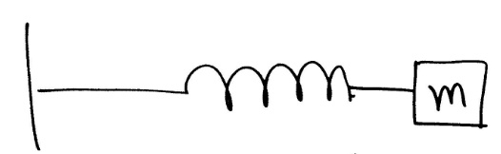
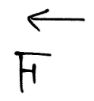
Same Force

Slide 5
Same Mass
Newton’s 2nd Law
Mass is resistance to rate of change of velocity

Slide 6
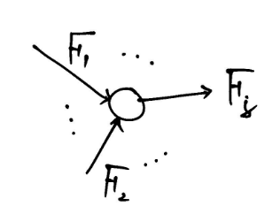
Free Body Force Diagram
Force is a vector concept
Total force is a vector sum of
Individual forces acting on the body

Slide 7
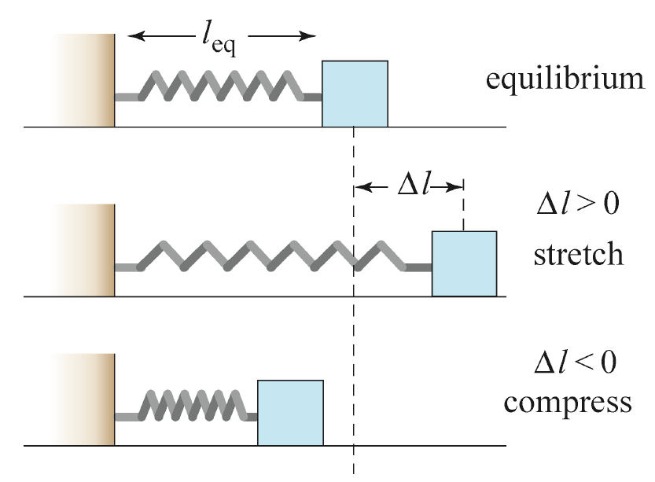
Spring Force

Slide 8
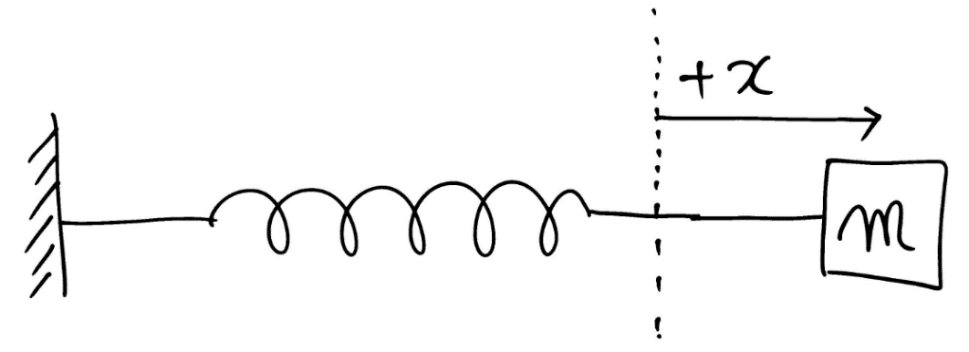

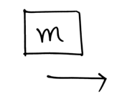

Spring Force
Kinematics
F.B.D

Slide 9
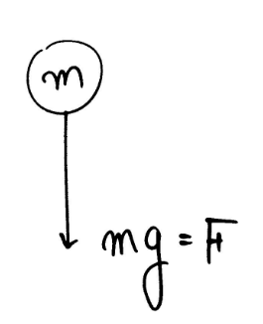

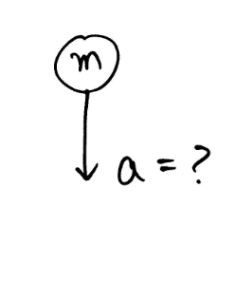
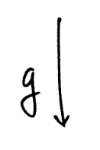
Gravitational Force Near the Earth

Slide 10


Newton’s Third Law: Action-Reaction Pairs
When two bodies interact via a force, then the force on one body is equal in magnitude and opposite in direction to the force acting on the other body

Slide 11
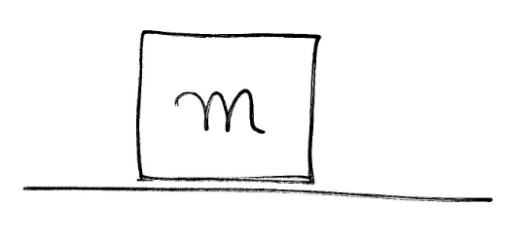
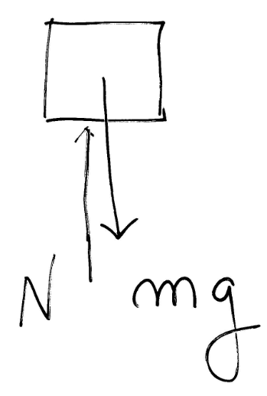

Example
F.B.D
m is at rest (a=0)
➔ No total external forces (N = mg)

Slide 12
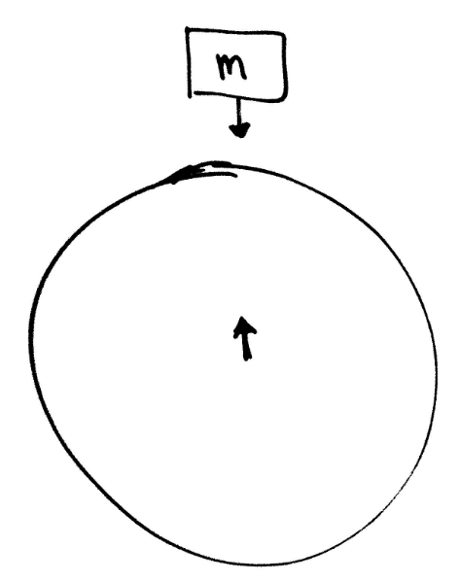
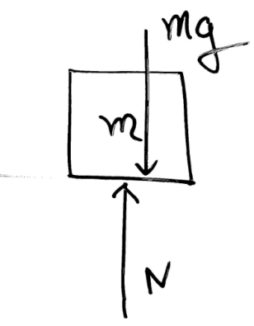
Action and Reaction
Action & Reaction forces between two objects

Slide 13
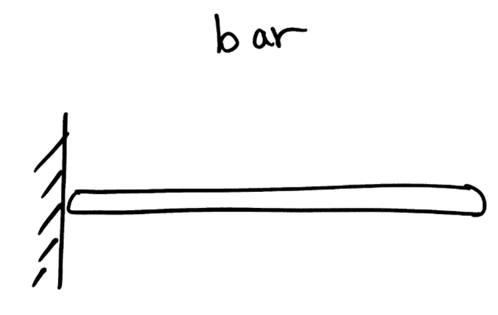
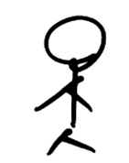

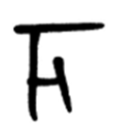
Example – Push

Slide 14
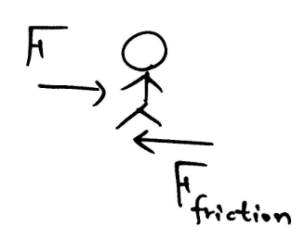
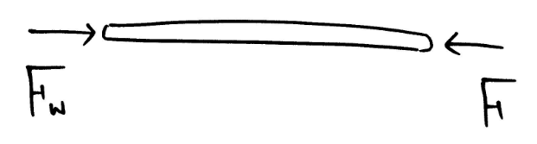
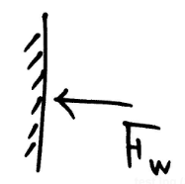
Example – Push
Person
Bar
Wall

Slide 15
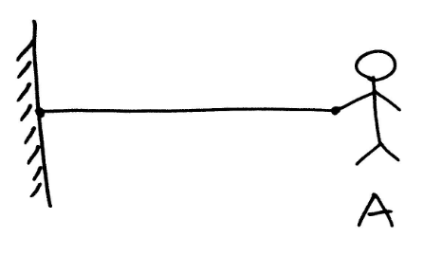
Example – Pull
A is pulling a string with force F
Tell all forces
F

Slide 16
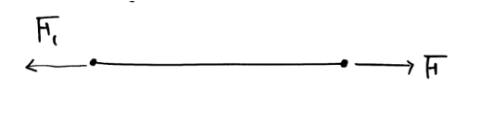
Example – Pull
String

Slide 17
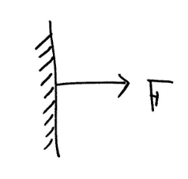
Example – Pull
Wall

Slide 18
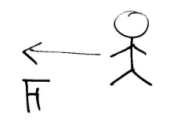
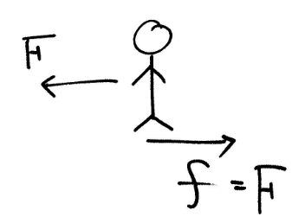
Example – Pull
Guy A
Why?
Friction

Slide 19
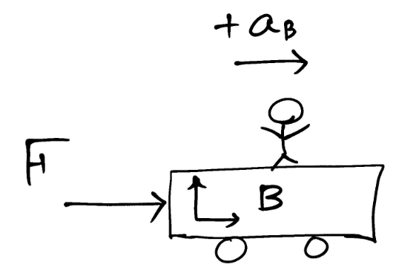
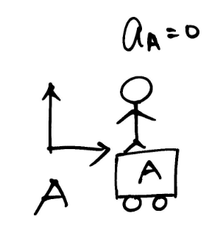
Example – Inertial Reference Frame

Slide 20
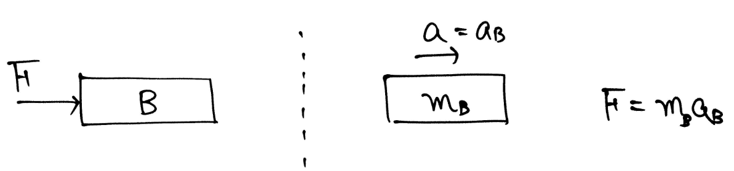
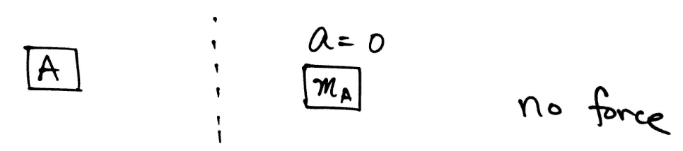
Example – Inertial Reference Frame
A point of view (A reference)
A : at rest
B : moves with +a

Slide 21
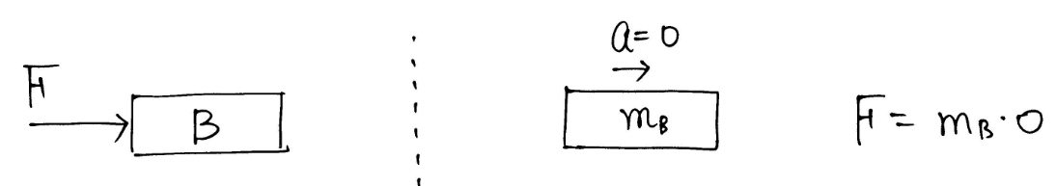
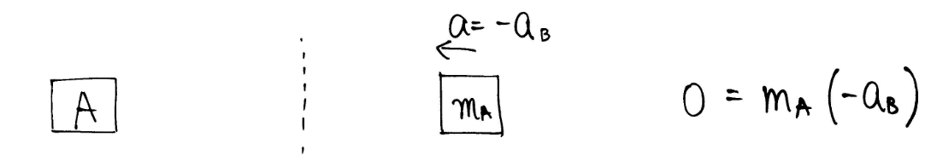
Example – Non Inertial Reference Frame
B point of view
Newton’s Law is wrong ?

Slide 22
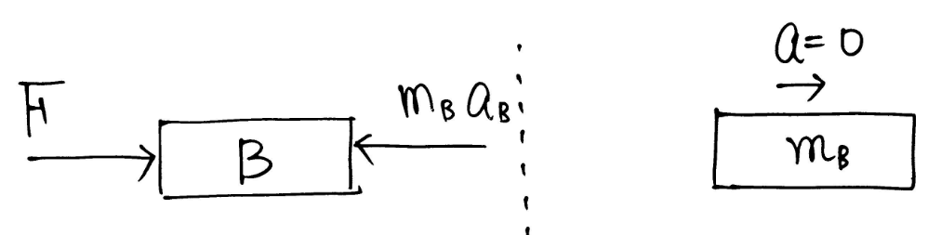
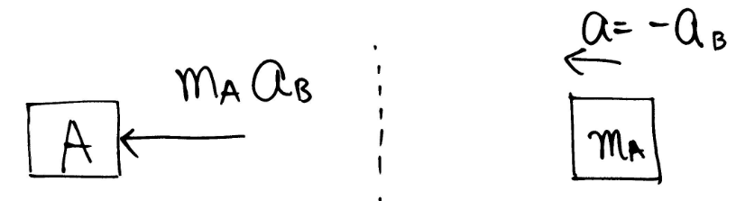
Example – Non Inertial Reference Frame

Slide 23
Inertia and the Right Hand Turn
Many students of physics do not believe in centripetal ("inwards") forces. Even after completion of a thorough physics course, such students will still incorrectly believe that an object moving in a circle experiences an outward force
The car is turning to the right due to the inward force, yet you feel as though you are being forced leftward or outward. In actuality, the car is beginning its turning motion (to the right) while you continue in a straight line path.
http://www.physicsclassroom.com/mmedia/circmot/rht.cfm

Slide 24
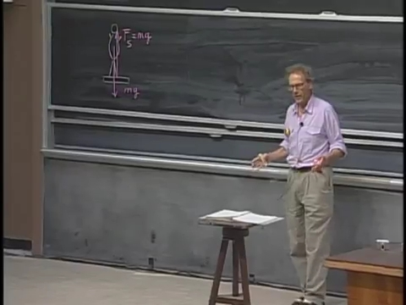
What is Weight?

Slide 25
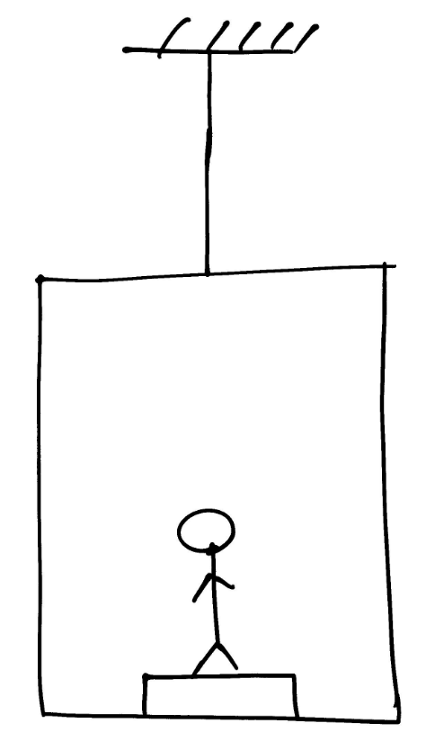
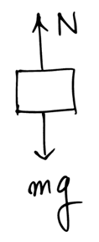
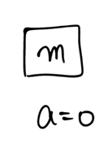

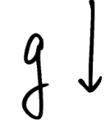
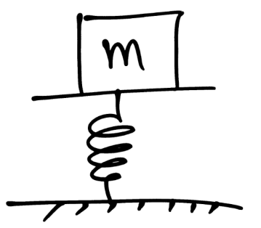
Weight

Slide 26
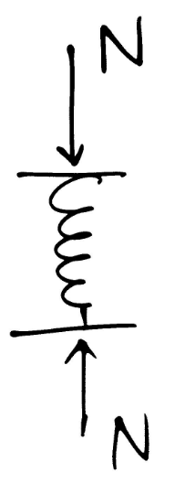
Weight
Spring is compressed by x
Weight = Normal force
on a scale

Slide 27
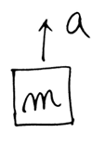
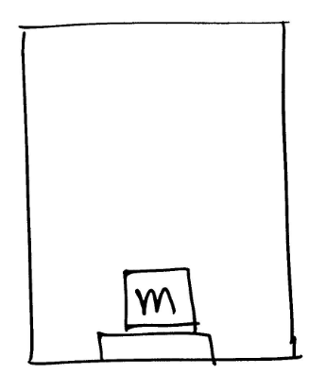
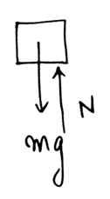


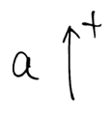
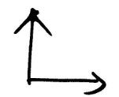
Example – Weight with an accelerated Elevator

Slide 28
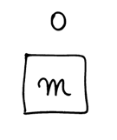
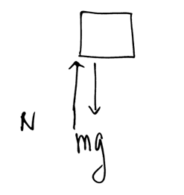


Example – Weight Seen from an Accelerated Elevator

Slide 29
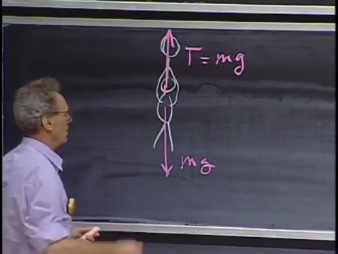
What is Weight in Tension?

Slide 30
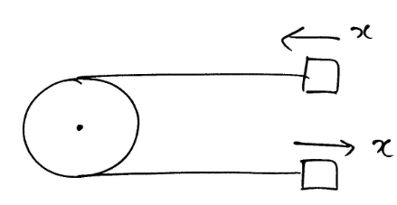
Problems with Pulleys
Ignore (mass, moment of inertia) of a pulley
→ It only change directions

Slide 31
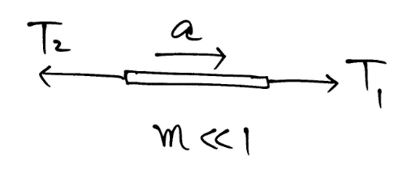
Tension on a String is Uniform (?)
Think of a small piece of string segment
: might have almost infinite acceleration

Slide 32
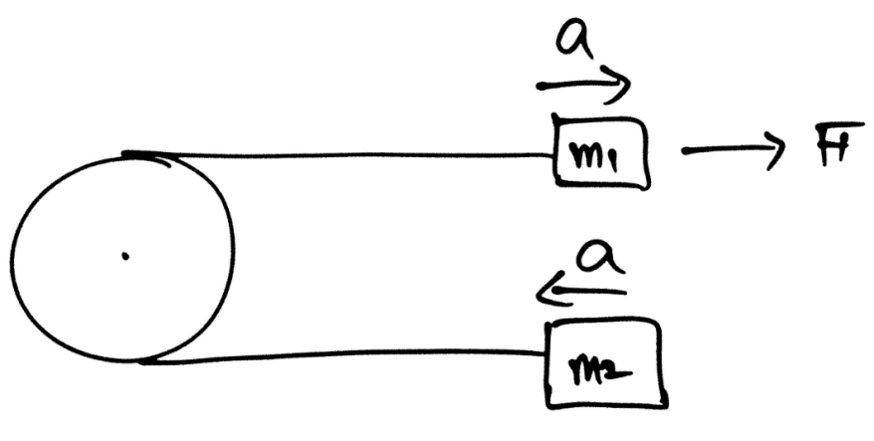

Example – Pulley

Slide 33

Example – Pulley

Slide 34


Example – Pulley

Slide 35

Force in a Circular Motion

Slide 36





Example – Inertial Circular Frame

Slide 37


Example – Non Inertial Circular Frame

Slide 38


Slide 39

Example

Slide 40

Example

Slide 41

Question

Slide 42
Question
Consider a car at rest on a level surface. We can conclude that the downward gravitational pull of Earth on the car and upward contact force of Earth on it are equal and opposite because
The two forces from an interaction pair
The net force on the car is zero
Neither of the above
Unsure

Slide 43

Question
A body of mass m is suspended from a spring with spring constant k in configuration (a) and the spring is stretched 0.1m. If two identical bodies of mass m/2 are suspended from a spring with the same spring constant k in configuration (b), how much will the spring stretch? Explain your answer.

